Slide 1

A Dynamic Program for Computing the Joint Cumulative Distribution Function of Order Statistics
Presenter: Rigel Galgana
Authors: Rigel Galgana*, Cengke Shi*, Takehiro Oyakawa, Amy Greenwald
*Both authors contributed equally
Notes:
15 seconds (15 cumulative)
Hi everyone. My name is Rigel and I’ll be presenting a Dynamic Program for Computing the Joint CDF of Order Statistics. My collaborators are Cengke Shi, Takehiro Oyakawa, and Professor Amy Greenwald all from Brown University.

Slide 2
Agenda:
Introduction
Related Work
Our Solution
Experiments
Conclusion & Future Work
Notes:
15 seconds (30 cumulative)
As an overview, we will first be presenting the setup and motivation for our problem. We then summarize existing solutions to the problem before providing our own take. We will then show a few experiments comparing several of the aforementioned solutions directly. To finish, we will quickly summarize and provide some potential future directions in which to take this project.

Slide 3
Agenda:
Introduction
Motivation
Problem Statement
Related Work
Our Solution
Experiments
Conclusion & Future Work
Notes:
15 seconds (30 cumulative)
Without further ado, let’s jump right in.

Slide 4
Introduction
Order Statistics: Definition
The kth order statistic of a sample set is equal to the kth smallest value.
For example, in a sample set of size n, the 1st and nth order statistics correspond to the minimum and maximum values.
Closely related to percentiles; take for example the median or 25th and 75th percentiles.
Notes:
15 seconds (45 cumulative)
So what is an order statistic?
The kth order statistic of a data set is defined as its kth smallest value.
Some commonly seen ones are the minimum and maximum, which in a dataset of size n, correspond to the first and n’th order statistics.
Order statistics are closely related to percentiles, for example, the median, or 25th and 75th percentiles, which are often included in summary statistics.

Slide 5
Introduction: Motivation
Applications
Arising naturally in many processes involving ranks, order statistics and their distributions have applications in many disciplines including:
outlier detection,
multiple comparisons testing,
empirical process theory,
digital signal processing,
mechanism design,
and more...
Notes:
15 seconds (60 cumulative)
In addition to their use in exploratory data analysis, order statistics naturally appear in various disciplines, including outlier detection, multiple testing, empirical process theory, signal processing, mechanism design, among others.

Slide 6
Introduction: Motivation
Properties
As a statistical measure, order statistics:
are easily interpretable,
have strong robustness guarantees,
are well-studied in certain contexts.
However:
they are less well understood in more general settings,
naive approaches to computing their joint distributions can be computationally complex.
Notes:
30 seconds (90 cumulative)
In practice, order statistics are often used as a statistical measure. In many instances, the median is often preferred to the mean as a descriptive statistic as
1) it is easily interpretable
2) is fairly robust to outliers, and
3) its behavior is well studied, at least under ideal contexts.
That being said,
order statistics are less well behaved under more general settings
and their joint distribution can often be difficult to compute.

Slide 7
Experiments: Applications
Example:
To illustrate this complexity, consider the hypothetical scenario: You are teaching a course of 100 students. To combat grade inflation, your department has mandated that at most 25% of the students may receive grades of A or higher.
You need to provide a cutoff x_{A} based on historical scores.
How do we select cutoffs? How ‘good’ is our x_{A}?
Notes:
45 seconds (135 cumulative)
To illustrate this complexity, we give an example. Consider this: you are the instructor of a large course of 100 students. This semester, your department has decided to combat grade inflation and mandated that at most 25 of your students can score A’s or higher.
Given historical student performances in your course, you must provide them with a cutoff score x_A, so as to comply with your department’s mandate without completely deflating grades.
How do we choose x_A? In this case, a straightforward approach to selecting x_A would be to treat student performances as i.i.d. and compute the distribution of the 75th order statistic at various candidate cutoffs. Simple enough right?

Slide 8
Experiments: Applications
Example Continued:
Additionally, the department requires that at most:
50% can get Bs or higher
75% can get Cs or higher
Now, you need to provide cutoffs x_{A}, x_{B}, x_{C} based on historical course score distributions.
How do we select cutoffs? Can’t consider each cutoff in isolation, as the 25th, 50th, and 75th order statistics are not independent.
Notes:
30 seconds (165 cumulative)
Well, let’s complicate the example slightly. We now assume that the department additionally requires at most 50% of students get B’s and at most 75% get C’s.
Now we must select cutoffs x_B and x_C in addition to x_A.
This becomes somewhat more problematic as our older approach of independently selecting a threshold no longer applies because the order statistics are dependent. We can further complicate our situation by relaxing our i.i.d. assumption, for example, by discriminating between students who are taking the course for a requirement and those who are not. We can also remove the independence assumption as students who work in groups tend to have more similar scores, or we can simply just add more grade thresholds. The problem quickly becomes difficult. To begin to approach this problem, we must first formulate it rigorously.

Slide 9
Experiments: Applications
Example:
To combat grade inflation, your department has mandated a max number of students with certain letter grades. At most:
25% can get scores of A or higher
50% can get Bs or higher
75% can get Cs or higher
As a course instructor, you need to provide approximate cutoffs x_{A}, x_{B}, x_{C} based on historical course scores. How to select cutoffs?

Slide 10
Introduction: Motivation
Example:
To maximize the number of tickets sold per plane, airlines often overbook, which comes with the risk of actually overbooking.
Say there are x_{B} and x_{E} business class and economy seats, with overbooked business class ticket holders being provided any unused economy class seats.
What is the probability of actually overbooking?

Slide 11
Experiments: Applications
Example:
You have d machines with memories x₁< ... < x_{d} and n jobs with sizes X₁,...,X_{n}.
As these jobs are urgent, we fit whatever we can into the local machines and feed the rest into a (expensive) supercomputer.
To minimize costs, we are interested in the probability the number of jobs left unprocessed.

Slide 12
Introduction: Problem Statement
Formalization
Let X₁ , … , X_{n} denote our real valued sample set with joint distribution F.
Let X_{(k, n)} denote the kth order statistic of these n random variables.
Let C = {c_{j}}_{j=1,...,d} denote an ordered set of indices of size d.
Let x = {x_{j}}_{j=1,...,d} denote an ordered set of real-valued bounds of size d.
We wish to compute: Pr(⋂_{j=1,...,d} {X_{(cj, n)} < x_{j}})
Notes:
45 seconds (210 cumulative)
Let X_1 through X_n denote our random variables distributed according to joint distribution F and let X_(k, n) denote the kth order statistic.
We additionally have a size d index set C, which contains the indices of the order statistics we wish to compute the joint CDF of at our bounds, small x.
The goal is to compute the probability that for all j in 1 through d, the c_j’th order statistic is at most small x_j.

Slide 13
Introduction: Problem Statement
Multiple Versions
In the most general case, without assuming independence or identically distributed, this problem is very difficult.
Several special cases under which the problem becomes more tractable:
Small number, say m, distributions (m = 1 corresponds to i.i.d)
Independence
Small index set or complete index set (i.e. C = {1, 2, … , n})
Notes:
30 seconds (240 cumulative)
From our example, this problem can become very difficult under the most general settings.
Fortunately, there are some assumptions on our random variables that can make our problem easier such as
identically distributed or
independence.
Additionally, some assumptions on our index set can greatly reduce the computational costs.

Slide 14
Introduction: Problem Statement
The Problem(s) of Interest
In the i.i.d. setting, we assume X_{i} ~_{i.i.d} F .
For the m-independent distributions setting, let n_{h} be the number of random variables {X_{i}^{h}}_{i=1,...,nh} from each distribution F_{h} for h = 1, … , m.
With size d index set C and bounds x, we provide an algorithm to compute Pr(⋂_{j=1,...,d} {X_{(cj, n)} < x_{j}}) in time polynomial in the n_{h}’s and d: O(d∏_{h=1,...,m} n_{h}²)
In this talk, we restrict attention to the i.i.d. setting, which is O(dn²)
Notes:
30 seconds (240 cumulative)
So which settings are we interested in then?
Well for starters, the i.i.d., d > 1 case is a good blend of practicality and complexity. In this setting, we simply assume X_i is distributed i.i.d. according to F. What’s nice about the i.i.d. case is that it generalizes naturally to the multiple distributions case.
That is, let there be m-homogeneous populations of independent random variables with n_h random variables drawn from each population with distribution F_h. In our previous example, you can think of these populations as the for-requirement and the non-requirement students.
In both cases, the goal is still to compute the joint CDF of the order statistics indexed by C at bounds small x. In particular, we wish to do this in time polynomial in the n_h’s and d, which are the population sizes and index set sizes.
In the next section, we will focus on the i.i.d. setting for the sake of notational simplicity.

Slide 15
Agenda:
Background & Problem Statement
Related Work
Conversion to Combinatorial Problem
Summary of Existing Methods
Our Solution
Experiments
Summary & Future Work
Notes:
15 seconds (255 cumulative)
Now we will take a look at the combinatorial equivalent of our problem and how our predecessors have approached the problem.

Slide 16
Related Work: Conversion to Combinatorial Problem
From Continuous to Discrete:
Observe: the event “X_{(cj, n)} is at most x_{j}” is equivalent to the event that “at least c_{j} random variables are at most x_{j}”.
Since the X_{i}’s are i.i.d., we can think of them as balls instead, and the regions between adjacent bounds as bins.
The problem is now: Pr(⋂_{j=1,...,d}{at least c_{j} balls in first j bins})
Notes:
30 seconds (285 cumulative)
In the conversion from the continuous to the discrete problem, the key observation is that the event that the c_j’th order statistic is less than or equal to small x_j is equivalent to the event that at least c_j random variables are less than or equal to small x_j.
Furthermore, since the X_i’s are i.i.d, we can think of them as indistinguishable balls. In addition, as the precise values of the random variables are irrelevant, we can also think of the regions between consecutive bounds as bins.
The problem now turns becomes computing the probability that, for all j in 1 through d, there are at least c_j balls in the left most j bins.

Slide 17
Related Work: Conversion to Combinatorial Problem
Combinatorial Notation:
Define [x_{j-1}, x_{j}) as the jth bin with x₀ = -∞, x_{d+1}= ∞
Define p_{j} = F(x_{j}) - F(x_{j-1}) as the probability that a ball falls into bin j.
Let C_{j} denote the number of balls in bin j. Let C_{a:b} = ∑_{j=a,...,b} C_{j} be the number of balls in bins a through b inclusive.
Let D_{j} = {C_{1:j} > c_{j}} denote the event “at least c_{j} balls in the first j bins”. Let D_{1:j} = ⋂_{j’=1,...,d}D_{j’}. We refer to D_{j} as the “jth bin condition”.
Notes:
30 seconds (315 cumulative)
So now some notation in combinatorial space. We define the space between the j-1st and jth bounds as bin j.
This bin has corresponding probability p_j equal to the difference of the CDF evaluated at the bin endpoints.
Now, we let count_j, which we denote here with big C_j, to be the number of balls in bin j, and similarly, count a to b as the number of balls in bins a through b inclusive.
Lastly, we define bin condition j, which we denote as D_j, as the event that at least c_j balls fall in the first j bins, with D_{1 through j} denoting the intersection of the first j conditions.

Slide 18
Related Work: Conversion to Combinatorial Problem
Combinatorial Problem Statement:
Original problem statement: Pr(⋂_{j=1,...,d} {X_{(cj, n)} < x_{j}})
Our new problem statement: Pr(⋂_{j=1,...,d} {C_{1:j} > c_{j}}) = Pr(D_{1:d})
Most existing methods (at least implicitly) compute the probability of exact ball configurations, e.g. events of the form ⋂_{j=1,...,d} {C_{j} = k_{j}} and sum over all vectors of ball counts k such that D_{1:d} holds. The number of such k is exponential in d.
Notes:
30 seconds (375 cumulative)
With the notation out of the way, we can formally rewrite the original continuous order statistic problem into a combinatorial one, which we denote as simply the probability of satisfying every bin condition.
So far our setup has been the same as existing methods, however, their approaches are doomed to exponentiality in d and in some cases, n as well. In particular, previous methods have simply enumerated and summed over all possible count configurations that satisfy all bin conditions. The number of such count configurations is exponential in d.

Slide 19
Related Work: Summary of Existing Methods
Existing Methods:
Method | Time Complexity | Additional
Bapat-Beg Theorem [1] | O(n^{d+1}2^{n-1}) | Analytic formula for m = n, assuming independence.
Glueck et al. [2] | O(∏_{h=1,...,m} n_{h}^{d} ) | Simplification of the permanents used in the Bapat-Beg Theorem for m < n, assuming independence.
Boncelet Jr. [3] | O(d^{|B|}n^{d+1}) | Allows for dependency, |B| is the maximum size of boundary set.
Bolshev Recursion [4] [5] | O(n²) | Only in case of m = 1, d = n, assuming independence.
Notes:
45 seconds (420 cumulative)
Here, we show some of the existing methods, their time complexities, and a few remarks on each.
Bapat-Beg theorem is the most general of the methods in the independent case, for d >= 1, m = n. The Bapat-Beg theorem requires the computation of an exponential in d number of block permanents of size n, each of which requires exponential time in n to compute.
An improvement upon the Bapat-Beg theorem, albeit still exponential in d is given by Glueck for the case of independent, d >= 1, m < n populations. This is the setting in which the algorithm we describe is optimal for.
Next we have Boncelet Jr.’s dynamic programming algorithm which also allows for dependencies between random variables. Our insight will also imply speed ups to this algorithm, though we will discuss this a bit more in the future works section.
The Bolshev is a poly-time algorithm, but strict conditions requiring m = 1, d = n, and independence, though recent work has shown that this can be extended to m = 2.
Our goal is to get the time complexity for the m populations, d > 1 case as per Glueck to look closer to the Bolshev recursion run-time.

Slide 20
Agenda:
Background & Problem Statement
Related Work
Our Solution
Key Insight and Recurrence Relation
Algorithm and Analysis
Experiments
Summary & Future Work
Notes:
15 seconds (435 cumulative)
Now that we’ve explained the existing methods and their pitfalls, we now provide our own method which circumvents this exponentiality in d. We will first show the insight in our approach then state the recurrence and algorithm explicitly.

Slide 21
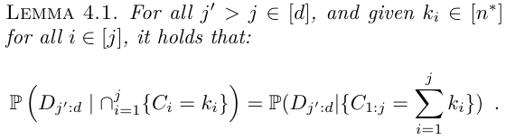
Our Solution: Key Insight and Recurrence Relation
Key Insight
When looking to satisfy D_{j}, the specific configuration of balls in bins 1 through j is irrelevant, as we only care about this sum.
Key insight: the probability of satisfying subsequent bin conditions given the configuration or sum of balls is the same.
Notes:
45 seconds (480 cumulative)
Recall that our goal is to satisfy all of the bin conditions, D_j. The key insight is that the bin conditions don’t rely on the exact ball count in each bin up to j, but rather only the cumulative sum in the first j bins.
So we now state our insight more formally. The probability of satisfying future bin conditions is the same regardless of conditioning on the exact configuration of the balls in past bins or their aggregate.

Slide 22
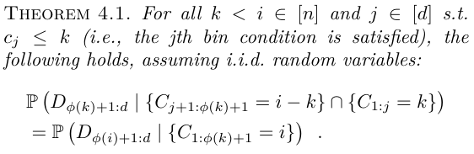
Our Solution: Key Insight and Recurrence Relation
Secondary Result
Let ɸ(k) denote the index of the largest D_{j} that is satisfied, assuming k balls in the first j bins.
Assume k balls in the first j bins and i balls in the first ɸ(k)+1 bins, the next theorem follows from our key insight:
Notes:
From our insight, we will derive an important corollary for which our recurrence relation heavily depends on. Let phi(k) denote the index of the largest bin condition, D_j, that is satisfied assuming that there are k balls in the first j bins.
Then, the probability of satisfying the unsatisfied bin conditions phi(k)+1 through d is equal regardless of the distribution of the balls among the first j bins and the next phi(k) - j bins versus the total number in both sets of bins.

Slide 23
Our Solution: Key Insight and Recurrence Relation
High Level Intuition
Assume k balls in the first j bins such that the first ɸ(k) bin conditions are satisfied.
Throw enough (i - k) balls into bins j + 1 through ɸ(k)+1 to satisfy the first unsatisfied bin condition, namely the ɸ(k)+1st.
Since bin conditions 1 through ɸ(i)+1 hold, forget configuration.
Repeat until all d bin conditions hold. Notice we did not track C_{j}’s!
Notes:
To provide a little bit more direction into how these results allow us to avoid having to track the count_j’s, and the exponentiality in d that comes with that, we give a high level idea of how our procedure works. First, assume k balls are in the first j bins such that the first phi(k) bin conditions hold.
Then, we throw enough balls into bins j+1 through phi(k)+1 in order to satisfy the first unsatisfied bin condition, D_(phi(k) + 1).
Having thrown a total of i balls in the first phi(k)+1 bins such that the first phi(i) bin conditions hold, we can forget the configuration, as we only consider satisfying the future bin conditions, D_phi(i)+1 forwards.
We will repeat this process until all d bin conditions hold. Notice here how we did not have to track individual count_j’s, but rather only their sums at the intermediate steps. With this in mind, we now give our main recurrence.

Slide 24
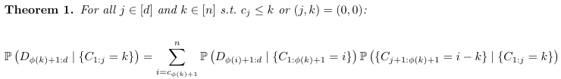
Our Solution: Key Insight and Recurrence Relation
Main Recurrence
Our recurrence relation follows:
The probability of D_{1:d} assuming k balls in the first j bins is equal to the weighted sum of D_{1:d} assuming i balls fall into the the first ɸ(k)+1 bins. Here, the weights are the probability that i - k of the remaining balls fell within bins j + 1 through ɸ(k)+1 → binomial.
Notes:
Assuming k balls in the first j bins, our main result states the probability of satisfying the remaining conditions phi(k)+1 forwards as the weighted sum of the probability of fulfilling the remaining bin conditions assuming i - k balls fell into bins j+1 through phi(k)+1. Here, the weights follow a binomial distribution with the probability parameter given as a function of the p_j’s, the bin ‘probabilities’.

Slide 25

Our Solution: Key Insight and Recurrence Relation
Recurrence in m > 1 case
We can vectorize the notion of C_{j} to track different types.
Still circumventing the problem of tracking C_{j} exactly

Slide 26
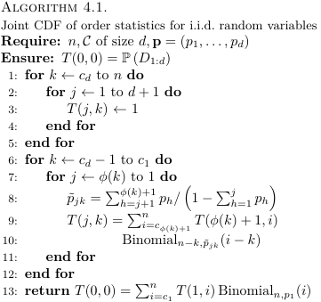
Our Solution: Algorithm and Analysis
Algorithm Statement
Let T(j, k) = Pr(D_{ɸ(k)+1:}|C_{1:j} = k)
There are O(dn) table entries to update, each requiring O(n) computations.
Space and time complexities are O(dn) and O(dn²) respectively.
These complexities are O(∏_{h=1,...,m} n_{h}) & O(d∏_{h=1,...,m} n_{h}²) with m-populations.
Notes:
With our recurrence relation defined, we now give the formal algorithm, with T(j, k) denoting the probability of satisfying the remaining bin conditions given k balls in the first j bins. The algorithm updates the entries of T in decreasing order of k, then decreasing order of j.
As there are O(dn) table entries to update with each requiring O(n) computations,
The space and time complexities are given by O(dn) and O(dn^2) respectively.
In the m-populations case, the only major difference in our algorithm made is that k and the count_j’s are vectorized to represent the random variables from the different populations. This will yield a space and time complexity which are still polynomial in the population sizes and index set size.

Slide 27
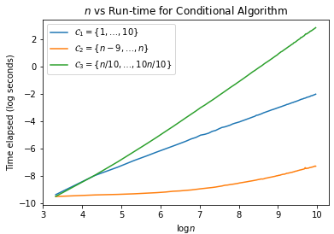
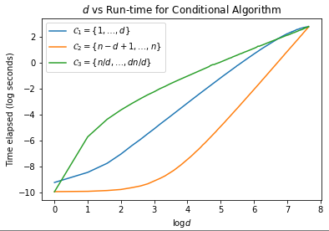
Our Solution: Algorithm and Analysis
Time and Space Complexity
To show O(dn²) time complexity, we vary n and d individually:
The ≅ 2 slope for C₁ and C₂ in the second graph does not contradict O(dn²) as in the first graph, they are approximately linear in n. The reason for this can be seen in next slide.
Notes:
To show empirically our space and time complexities, we plotted our algorithm’s elapsed time on problems with either fixed population size and varying index set size, or fixed index set size and varying population size. We additionally use three different index set types, they first being the first few order statistics, the second being the last few, and the third being equally spaced.
As these are log-log plots, in the second figure, the slope of roughly 2 for index sets 1 and 2 seemingly contradict the runtime of O(dn^2). However, this is because their time dependency in n is linear, and since n > d, this is still technically O(dn^2).

Slide 28
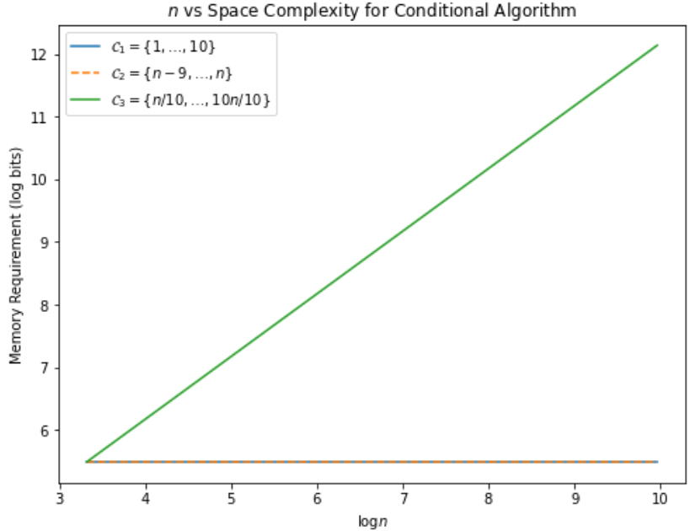
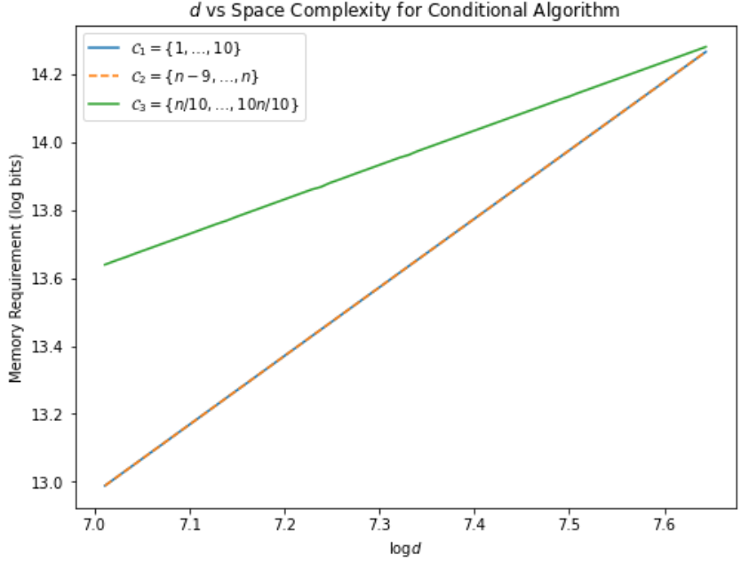
Our Solution: Algorithm and Analysis
Time and Space Complexity
The stated O(dn) and O(dn²) complexities mask the effect of the index set C. The space complexity grows faster in d for C₁ and C₂, as they are constant in n.
Notes:
Now for the space complexity experiments, we see the reason behind why index sets 1 and 2 grow slower in n but faster in d, as the table size is growing in O(d^2), which is still technically O(dn), whereas index set 3 is approximately linear in both.

Slide 29
Agenda:
Background & Problem Statement
Related Work
Our Solution
Experiments
Summary & Future Work
Notes:
Now we do a bit of side by side comparison with existing methods.

Slide 30
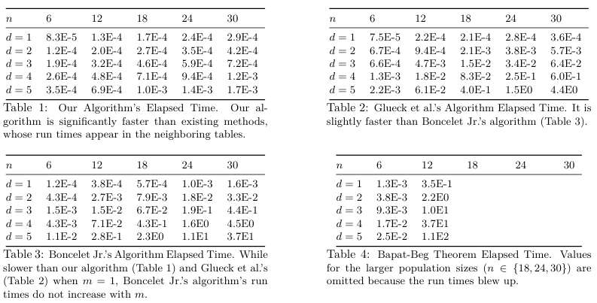
Experiments:
Comparisons with Existing Methods
Notes:
Here, we have elapsed run-times of our algorithm compared to Glueck’s, Boncelet Jr.’s, and the Bapat-Beg theorem in the i.i.d. Case. Notice that for small d, our method is comparable to Boncelet Jr.’s and Glueck’s procedures, however, for larger values of n and d, the difference becomes clear. The scientific notation also makes it easier to see the exponential behavior in d that the other algorithms exhibit.

Slide 31
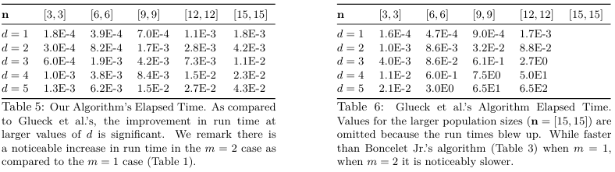
Experiments:
Comparisons with Glueck, m = 2
Our algorithm runs in O(dn₁²n₂²) time and Glueck’s in O(n₁^{d}n₂^{d}).
Notes:
To compare the run-times for the case of two populations, we compared our algorithm to Glueck’s and found the same trend as before, where the two procedures are comparable for small d but clear for larger problem sizes. We note that Boncelet Jr.’s and Bapat-Beg’s methods will take the same time as in the previous slide as their run-times are distribution agnostic.

Slide 32
Agenda:
Background & Problem Statement
Related Work
Our Solution
Experiments
Summary & Future Work
Notes:
Now for some closing remarks.

Slide 33
Summary & Future Work: Summary
Summary:
Convert continuous problem statement Pr(⋂_{j=1,...,d} {X_{(cj, n)} < x_{j}}) into discrete problem statement Pr(D_{1:j}).
Bypass tracking each C_{j} individually by only considering their sums when trying to fulfill the unsatisfied bin conditions (D_{j}’s).
Improved best known run-time of m-populations case from Glueck’s O(∏_{h=1,...,m} n_{h}^{d} ) to O(d∏_{h=1,...,m} n_{h}²).
Notes:
So what did we cover today? First, we transformed a continuous order statistic problem into a combinatorial one involving throwing a sufficient number of balls across various bins.
Our approach dodged exponentiality in d by ignoring the individual count of each bin and only considering their sums when trying to fulfill bin conditions.
This allowed us to improve the best known run-time of the m-populations case from Glueck’s, which is exponential in d, to one that is linear in d.

Slide 34
Summary & Future Work: Future Work
Future Work:
Apply the same insight to improve existing algorithms. Can be used to speed up Boncelet Jr.’s algorithm.
Compute the probability of order statistics being bounded from above and below, i.e. Pr(⋂_{j=1,...,d} {x_{j} < X_{(cj, n)} < y_{j}}).
Is it possible to do even better? Perhaps polynomial in m as well? Or can we prove that this is impossible?
Notes:
Our insight also applies more generally, in particular to Boncelet Jr.’s method. At a high level, his algorithm maintains the distribution of the first i balls across each bin and uses this to compute the distribution of the first i+1 balls across the bins. Instead of tracking each C_(i, j), which is the number of the first i balls in bin j, we can instead track C_(i, 1:j), the aggregate sum and then ‘spill over’ any remaining balls from bins that are satisfied over to the next unfulfilled bin.
On a similar note, we can extend our algorithm to handle double sided bounds on each order statistic. This would be relevant when computing robustness properties of sets of order statistics such as constructing confidence bands around empirical distributions, like in the DKW inequality, except at multiple points. This can be done by modifying the set of summation in our recurrence relation to prevent too many balls from landing in a range of bins, as now we will also need to lower bound the number of balls that fall in the last j bins.
Lastly, we must ask: how good can the algorithms get? All of the existing methods are exponential in at least one of n, d, or in our case, m. Perhaps it might be possible to prove that the Bapat-Beg solution is as efficient as it gets in the most general case or reduce to a known NP-hard problem, such as computing block permanents.

Slide 35
Thanks!
Notes:
Before I finish, I would just like to thank the audience for tuning in, as well as our reviewers, who have provided very useful feedback.
And with that said, that’s a wrap, thank you all again!

Slide 36
Conclusion & Future Work: Future Work
Possible New Directions:
Is it possible to do even better? Perhaps polynomial in m as well? Or can we prove that this is impossible?
How does the numerical stability of our method compare with existing methods? (ADD Dickhaus CITATION!)
Can we characterize the error of our algorithm’s output assuming noisy versions of the input distributions?

Slide 37
Background
Background & Problem Statement
References
R. B. Bapat and M. I. Beg, Order statistics for nonidentically distributed variables and permanents, The Indian Journal of Statistics, Series A, 1989, pp.~79--93.
D. H. Glueck, A. Karimpour-Fard, J. Mandel, L. Hunter, and K. E. Muller, Fast computation by block permanents of cumulative distribution functions of order statistics from several populations, Communications in Statistics: theory and methods, 37 (2008), pp.~2815--2824.
C. G. Boncelet Jr., Algorithms to computer order statistic distributions, SIAM Journal on Scientific and Statistical Computing, 8 (1987), pp.~868--876.
G. Shorack and J. Wellner, Empirical Processes with Applications to Statistics, Society for Industrial and Applied Mathematics (1996)
J. von Schroeder and T. Dickhaus, Efficient calculation of the joint distribution of order statistics, Computational Statistics and Data Analysis, 144 (2020).

